Slide 1

Continuing Tasks
Notes:
1

Slide 2
Objectives
Understand the differentiate between episodic and continuing task
Using discounting for continuing tasks
Continuing Tasks
2
Notes:
2

Slide 3
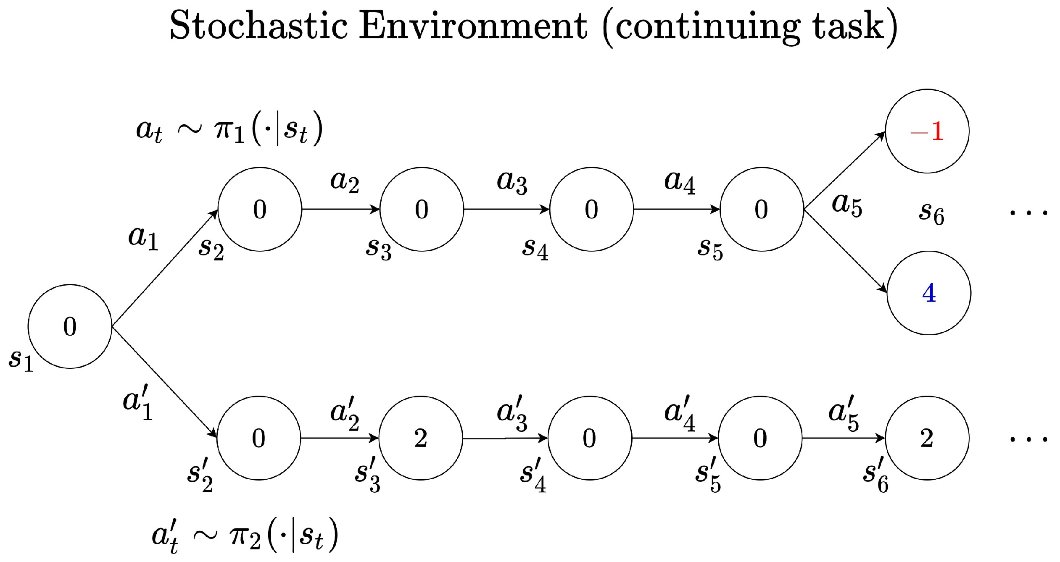
Continuing tasks
Continuing tasks, also known as ongoing tasks or recurring tasks, are activities that require regular attention and maintenance over an indefinite period. These tasks do not have a defined endpoint and typically repeat at regular intervals or as needed.
3
Continuing Tasks
Notes:
3

Slide 4
Continuing tasks
Characteristics of Continuing Tasks:
Ongoing Nature: Continuing tasks persist over time and require continuous attention and effort.
Regular Intervals: They may occur at regular intervals, such as daily, weekly, monthly, or annually, depending on the nature of the task.
No Defined Endpoint: Unlike episodic tasks, continuing tasks do not have a clear endpoint or completion date. They continue indefinitely or until they are no longer necessary.
4
Continuing Tasks
Notes:
4

Slide 5
Continuing tasks
Characteristics of Continuing Tasks:
Maintenance and Monitoring: These tasks often involve regular maintenance, monitoring, and adjustment to ensure they are performed effectively and efficiently.
Evolution Over Time: Continuing tasks may evolve over time to adapt to changing circumstances, requirements, or priorities.
5
Continuing Tasks
Notes:
5

Slide 6
Continuing tasks
 | Episodic Tasks | Continuing Tasks
Definition | Episodic tasks are those that have a distinct beginning and end. They are typically discrete activities or projects with a defined goal or outcome | Continuing tasks, also known as ongoing tasks or recurring tasks, are those that persist over time without a defined endpoint. They are activities that require regular attention and maintenance.
Duration | These tasks are time-limited and are usually completed within a relatively short timeframe. | These tasks are indefinite and repeat at regular intervals or as needed.
Examples | Writing a report, completing a specific project, organizing an event, or studying for an exam are examples of episodic tasks. | Routine administrative tasks, managing a website, providing customer support, and maintaining equipment are examples of continuing tasks.
6
Continuing Tasks
Notes:
6

Slide 7
Continuing tasks
 | Episodic Tasks | Continuing Tasks
Characteristics | They often require a focused effort until completion. They have clear objectives and deliverables. Once finished, they do not require ongoing attention or maintenance. | They require ongoing effort and attention. They may not have clear endpoints and may evolve over time. They often involve regular monitoring and adjustment to meet changing requirements or conditions.
7
Continuing Tasks
Notes:
7

Slide 8
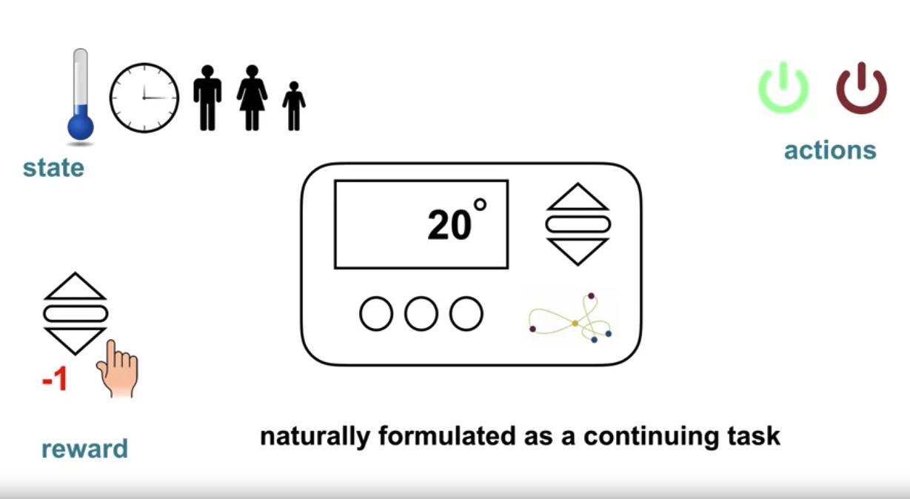
Continuing tasks
Example: Smart thermostat which regulates the temperature of a building
8
Continuing Tasks
Notes:
8

Slide 9
Continuing tasks
Example: Smart thermostat which regulates the temperature of a building
The thermostat never stops interacting with the environment.
The state could be the current temperature along with details of the situation like the time of day and the number of people in the building.
There are just two actions, turn on the heater or turn it off.
The reward to be minus one every time someone has to manually adjust the temperature and zero otherwise.
To avoid negative reward, the thermostat would learn to anticipate the user's preferences
9
Continuing Tasks
Notes:
9

Slide 10
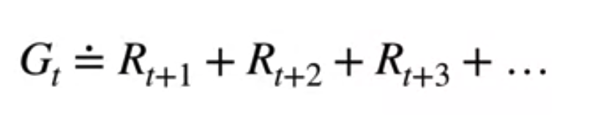
Continuing tasks
Interaction goes on continually
No terminal state
We're summing over an infinite sequence. This return might not be finite. What is solution ?
10
Continuing Tasks
Notes:
10

Slide 11
Discounting
Discount future rewards by a factor Gamma called the discount rate.
Gamma is at least zero, but less than one.
The return formulation can then be modified to include discounting.
The effect of discounting on the return is simple, immediate rewards contribute more to the some.
Rewards far into the future contribute less because they are multiplied by Gamma raised to successively larger powers of k
11
Continuing Tasks
Notes:
11

Slide 12
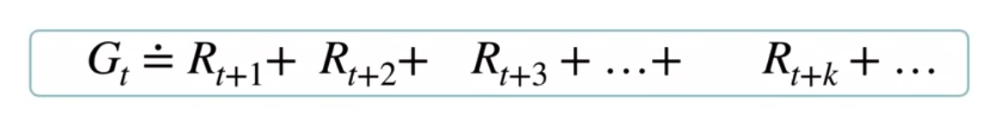
Discounting
Discount the rewards in the future by gama, where 0<gama<1
12
Continuing Tasks
Notes:
12

Slide 13
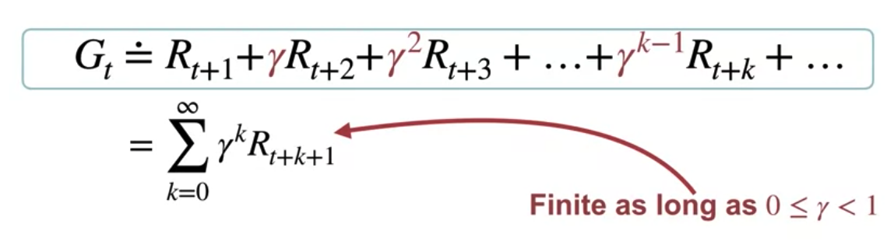
Discounting
We can concisely write this sum as this expression, which is guaranteed to be finite.
13
Continuing Tasks
Notes:
13

Slide 14
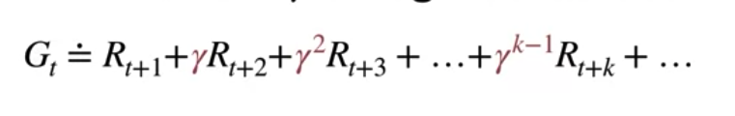
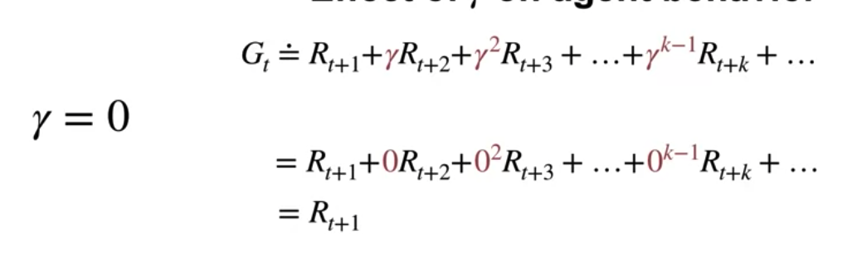
Discounting
The effect of gama on agent behavior
When Gamma = 0 the return is just the reward at the next time step. So the agent is shortsighted and only cares about immediate expected reward.
14
Continuing Tasks
Notes:
14

Slide 15
Discounting
The effect of gama on agent behavior
when Gamma approaches one, the immediate and future rewards are weighted nearly equally in the return. The agent in this case is more farsighted.
15
Continuing Tasks
Notes:
15

Slide 16
Student task
Give an example of a continuing task, and analyze its components: agent, environment, state,...
16
Continuing Tasks
Notes:
16

Slide 17
Summary
Understand the differentiate between episodic and continuing tasks
Using discounting for continuing tasks
Continuing Tasks
17

Slide 18
Q & A
Continuing Tasks
18

